Slide 1
Dealing with Information Loss
How Information Loss Happens and Methods for Correction
By Alex Georgescu, Data Scientist

Slide 2
Why care about missing data?
Missing data is a common problem in statistical analysis and machine learning.
Necessary for evaluating data quality and its impact on the final results ("garbage in, garbage out").
Missing data needs to be addressed properly in order to retain both the size of the observations and their quality.
Notes:
We are going to cover three kinds of missing data. Take note of the fourth kind that we will discuss later, this is a kind of missing data but outside of the the traditional three classes of statistical data loss.
MACR, missing at conditional random is commonly referred to as MAR but for simplicity and to avoid ambiguity, I will refer to it as missing at conditional random because there are subtle but notable differences why information goes missing in that example.

Slide 3
Missing Data Mechanism
The nature or mechanism of missing data can be categorized into three major classes.
These categories are based on the degree of relationship between the nature of the missing data and observed values.
There are 3 kinds of missing data: MCAR — missing completely at random CMAR — conditional missing at random, commonly referred to as MAR MNAR — missing not at random
Note: the examples shown in this presentation are all related to image processing, where missing data has a critical importance and missingness is visually apparent.
Notes:
We are going to cover three kinds of missing data, but there is a fourth kind I am going to mention later.
MACR, missing at conditional random is commonly referred to as MAR but for simplicity and to avoid ambiguity, I will refer to it as missing at conditional random because there are subtle but notable differences why information goes missing in that example.

Slide 4
Missing Completely At Random (MCAR)
Missingness of observations data is completely unsystematic and inconsistent.
Some examples:
poor record keeping
repository fire
unreliable data collection agents
Missing because of unpredictable events having nothing to do with the data.
Notes:
Customer data goes missing simply because of an unpredictable and random event. The same level of data loss is mostly equal for all the different kinds of customers. No bias, no class of customers is affected more than another.
An algorithmic way to do this would be Little's MCAR test. There exists a library for Python called impyute that does this test.

Slide 5
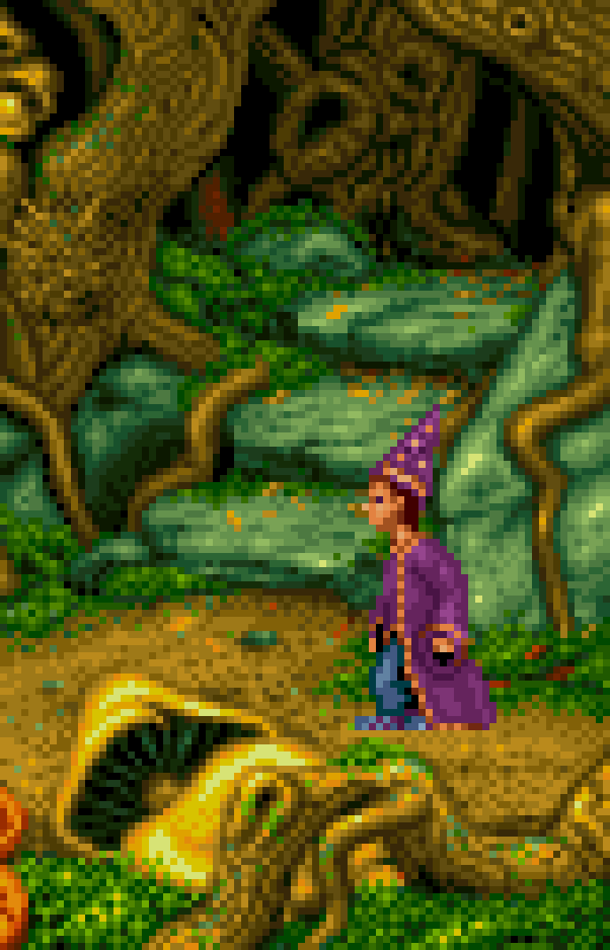
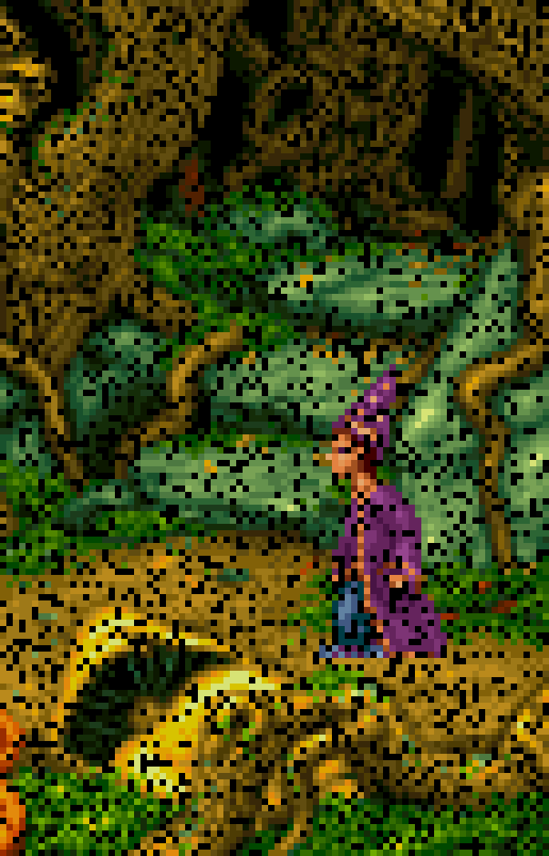
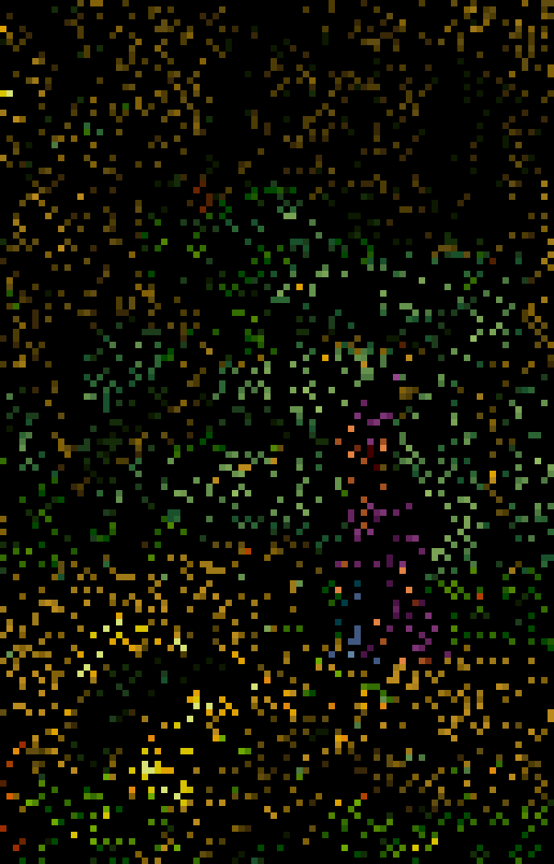
Missing At Conditional Random
Ground Truth Degraded Difference
Notes:
This is a photo of

Slide 6
Conditional Missing At Random (MAR)
Nature of the missing data is related to the observed data but not the missing data
Some examples:
parents move to different province and children’s learning progress on specific topics is lost
persons belonging to a subgroup are more unreliable when polled
Missing because of an unknown relationship/correlation with the data.
Notes:
There is an unknown and unobserved relationship/correlation between the different kinds of customers and the level of data loss.
For example, your customers, all the male ones will have higher data loss than the female ones but the gender/sex of the individuals is unknown/unobserved for you to do your analysis. If you had enough information about your customers you might be able to infer their sex/gender with some accuracy.
This is almost impossible to test for and usually requires deep insight into your data. This is where machine learning happens, to try and predict and infer what is happening and discover new patterns and correlations in the data.

Slide 7
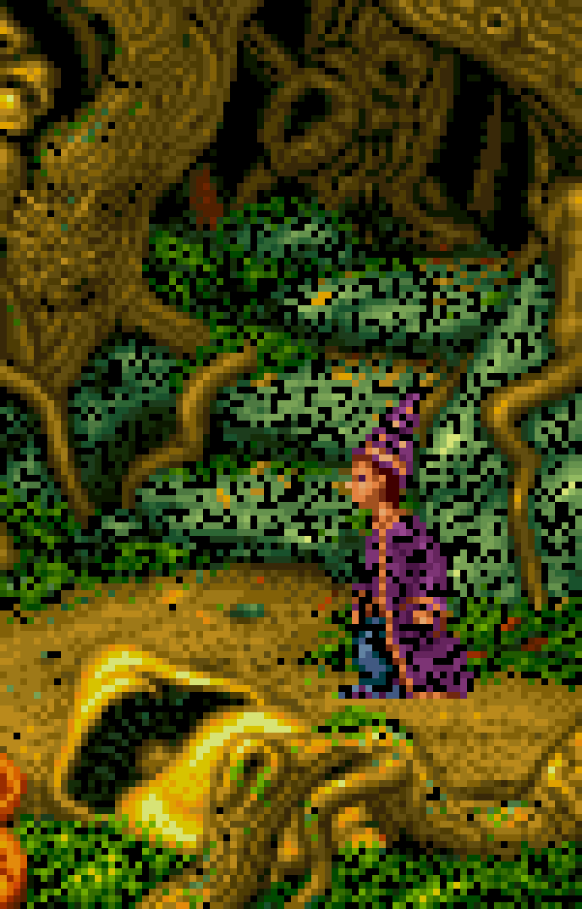
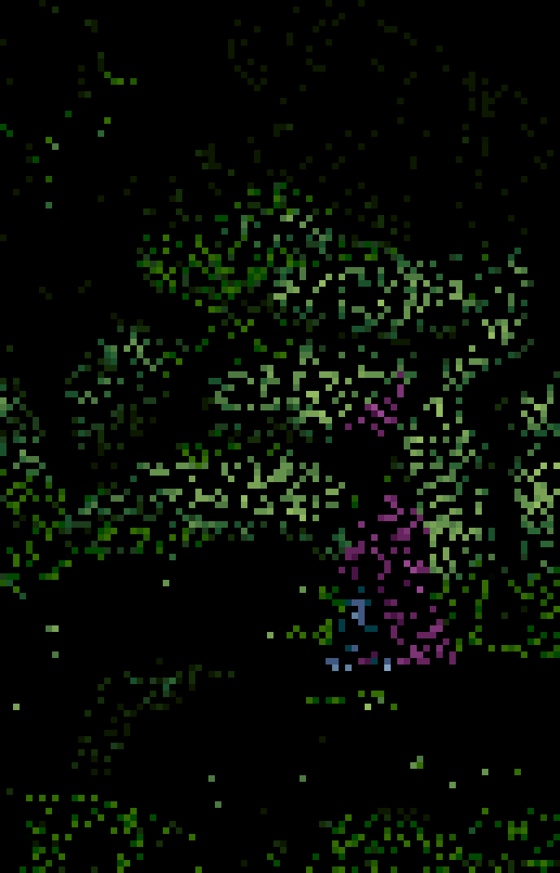
Conditional Missing At Random
Ground Truth Degraded Difference
Notes:
Ripples are caused by other ripples, they have a correlation to each other but what is the source in the center? With enough time to observe the ripples you might be able to tell something about that unknown but you will never be sure.
The unobserved/missing part of the data is affecting the observed data.
Cut out everything but the ducks, only the water is visible via sampling (select water range in photoshop)

Slide 8
Missing Not At Random
(MNAR)
Also known as non-ignorable because the missingness mechanism will create bias.
Exists when the missing values are neither MCAR or MAR.
Example:
poll on smoking results in smokers not being honest
Missing due to unknown factors within the data itself.
Notes:
There is an unknown/unobserved relationship directly influenced by the data itself, and the values recorded in the data determine the relationship of missingness within the data. This is circular reasoning of sorts, and this type of data loss is the hardest to determine and to test for.
For example, if you were doing a survey on overdue library books and asked the person their name and the number of overdue books, many respondents wouldn’t want to release their name and the number of books and many would simply either lie or skip the question. The level of data missingness in this case is due to the data itself.

Slide 9
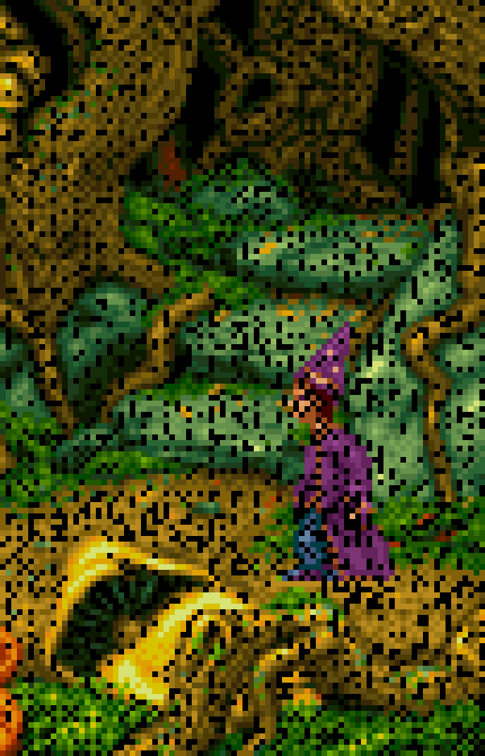
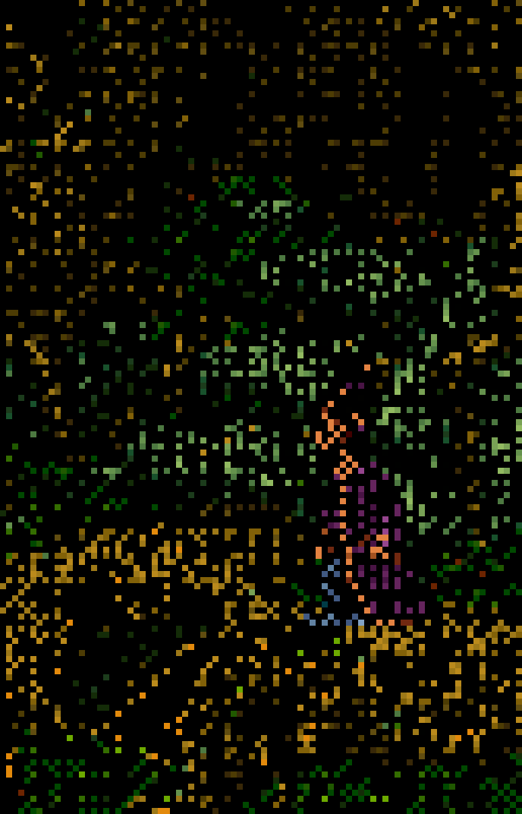
Missing Not At Random
Ground Truth Degraded Difference
Notes:
Why is the data missing? If this was a camera, there could be all sorts of reasons. Maybe somewhere in the compression pipeline there is an error. Because the data is not MCAR/randomly missing, we can determine that it’s not a physical problem with the sensor or whatever collects the data.
So how was this image created? I took Simon here and I reduced the color using Photoshop’s export GIF using error-diffusion pattern dithering. The way the software pipeline works, the image interacting with the quantizer threw out some irrelevant data to meet my compression and color constraints. In this case it used a fixed pattern to throw out data and it appears that all channels are affected similarly but there are obvious visual patterns. Then I took some channel differences and some level differences, some color inversions and layer multiplication until I had a pattern that I was happy with. All in photoshop.
If I had a cleaner image, or a larger image I could show you how the patterns look. Or you can look at the code and see for yourself how the algorithm is affected by the data.

Slide 10
Comparison Between MCAR, CMAR/MAR, MNAR
MCAR CMAR/MAR MNAR
Notes:
Even once the data is visualized, it’s hard to tell what is missing and why. When we put together the different observations of the different data sets, we can more easily compare.
This is an easy example because it’s visual. Sound is also fairly easy because it can be visualized or listened to, however it still needs transformation into that kind of format.

Slide 11
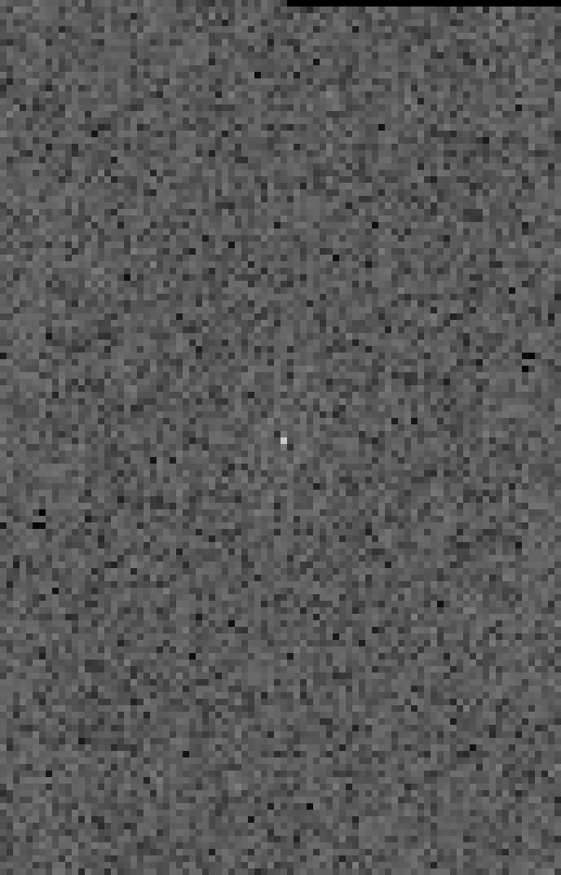
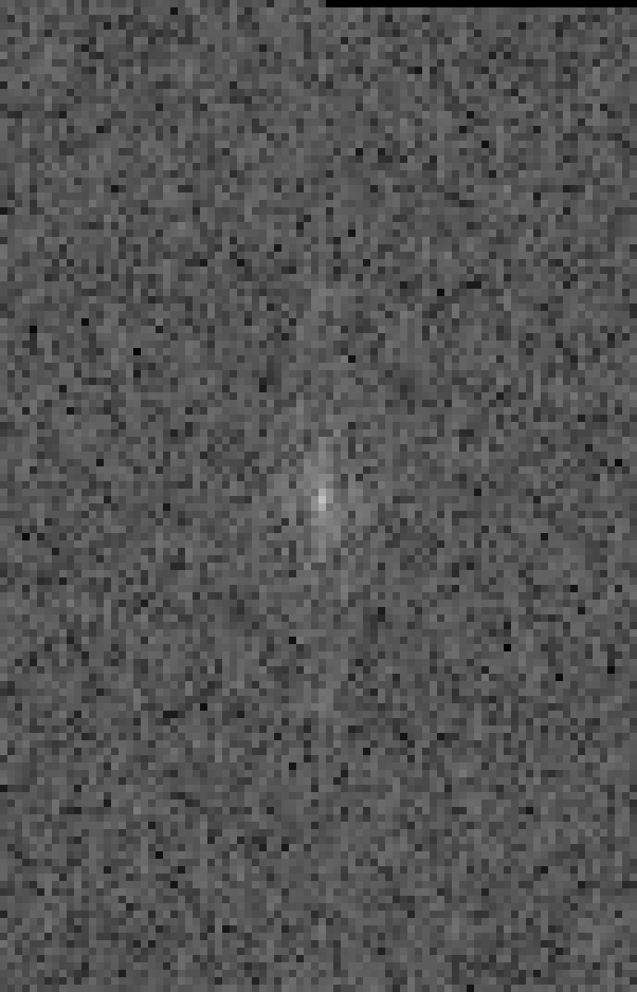
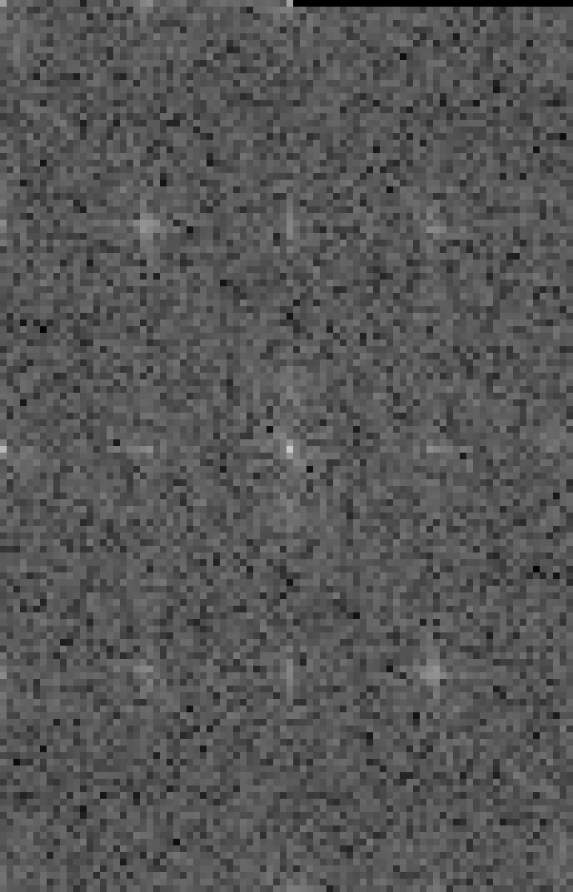
MCAR, CMAR, MNAR Fourier Transforms
MCAR CMAR/MAR MNAR
Notes:
The Fourier images are of the difference images, the missing data but equalized the brightness. This makes the subtle patterns in the fourier space more obvious, for using as a low res example.
Even once the data is visualized, it’s hard to tell what is missing and why. When we put together the different observations of the different data sets, we can more easily compare. MNAR, has the most repeating noise which shows up as a constellation in the Fourier, CMAR/MAR is more focused around the centre because it’s a larger mass of data the missingness is focused around, and MCAR is completely randomly spread out and the subtle data loss doesn’t appear to show any pattern in the Fourier.

Slide 12
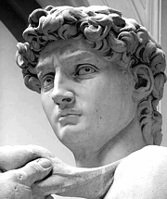
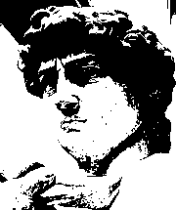
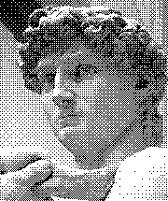
What is dithering?
Ground Truth Threshold Bayer Pattern Dither
Notes:
So how does dithering work? It’s a way to throw out data but preserve the overall structure of the data for the purposes of compression. Which data is kept and which is thrown out and which is transformed into this stippling pattern is determined by the algorithm underneath.
This example actually shows us how you can determine if something is MCAR, MACR, or MNAR. If you had enough samples of these black and white 1-bit images, you could reconstruct the ground truth (the true data) and you could determine how the data in each observation was warped and manipulated from this truth. It’s exceptionally difficult and requires massive amounts of data.

Slide 13
Dithering Cont...
Dithering is a way to sample/quantize an image ground truth and into an approximation.
It allows us to selectively delete data and transform the remaining data into a less complex representation for compression purposes. Dithering preserves complex smooth gradients but at the cost of high frequency detail.
Dithering is an excellent example of MNAR because the observed data is interacting with an algorithm (unobserved data) to create the output data missingness.

Slide 14
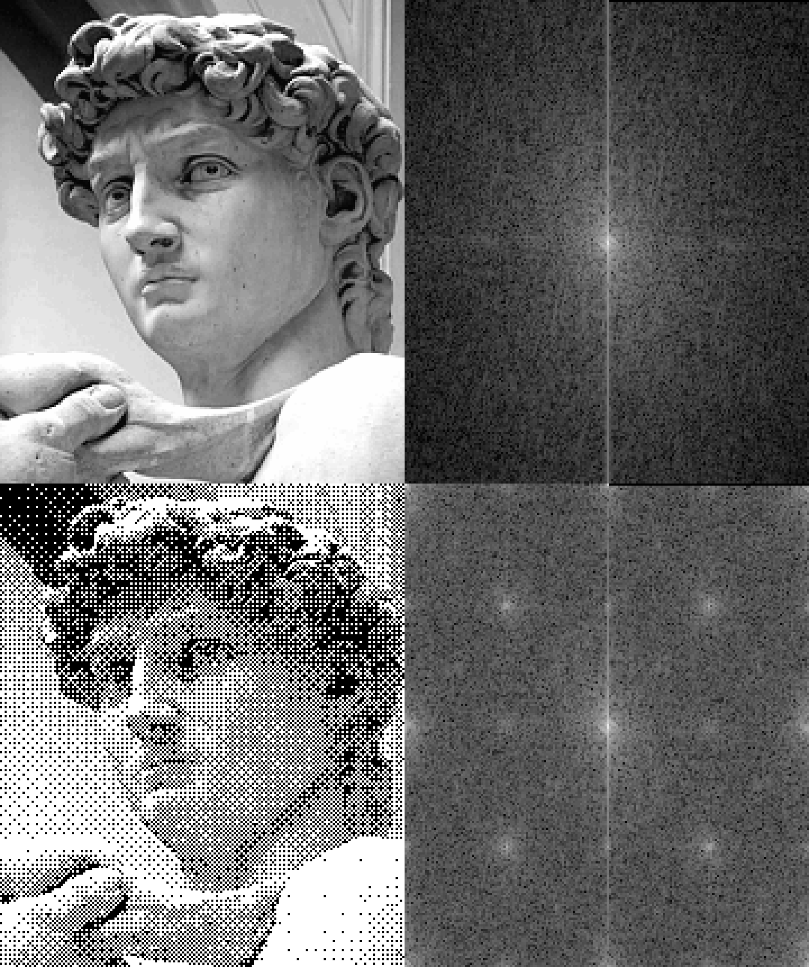
Another Fourier Example
Notes:
Transforming the data may be the only way to visualize errors within the data. In the visual world, for processing and compression, there exists the Fourier Transform and it allows us insights into the data we might not otherwise have.

Slide 15
Further reading
The clearest academic example I could find by John W. Graham, Professor of biobehavioral health, at Penn State University.
https://www.personal.psu.edu/jxb14/M554/articles/Graham2009.pdf
There are also many articles covering this important subject. You can simply Google “MCAR MAR MNAR” and find many examples.
Notes:
This is a 43 page article published in the Annual Review of Psychology Journal

